Slide 1
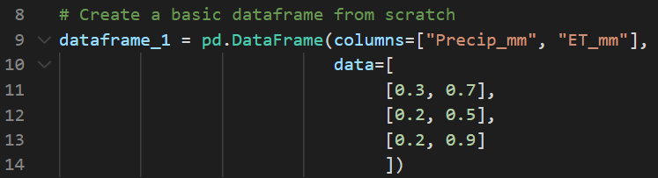
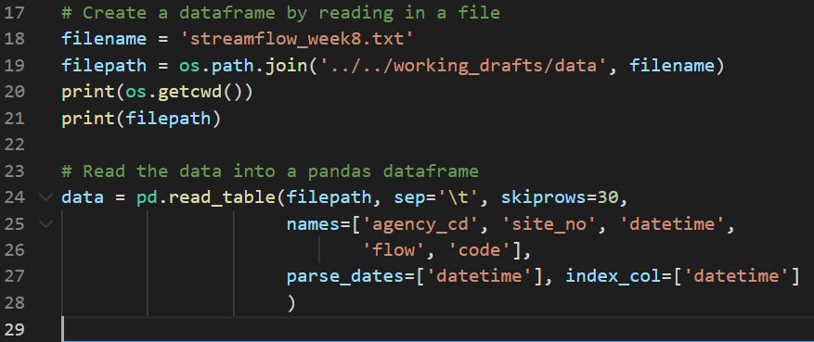
What are they and how are they different from the other object types we have worked with so far
Pandas series (1-D) & dataframes (2-D) are objects that can store data in table form, and can store multiple data types (unlike numpy arrays)
How to make a pandas dataframe from scratch & by reading in a csv
See pictures
Create a cheat sheet on Pandas basics that covers the following:
Summarize Pandas
How to slice pandas dataframes -- both using loc and iloc
.iloc = uses the index location within a dataframe to select data
Have to give row selection and then column selection
Ex: dataframe_1.iloc[0:2, 0:2] gives the first 2 rows in the first two columns of the dataframe
.loc = uses the “name” of an index label to select data, whatever the label of the index values happen to be
What is the index of a pandas dataframe -- why is it different than other columns and how can you work with it?
Index won’t show up as a column if trying to call it as a column
Can use dataframe_1[[‘column1’]] to pull just the data from column 1 into a new dataframe
Can use .iloc or .loc to access the index
Key methods associated with pandas dataframes
.set_index() = sets a designated column as an index
.head() = default gives the first 5 rows of data in the dataframe
.tail() = default gives the last 5 rows of data in the dataframe
.describe() = gives summary statistics of the dataframe
Key attributes associated with pandas dataframes
.index = lists all the index values that are set in a dataframe
.columns = lists all the column names that are in the dataframe
Pandas Cheat Sheet

